Slide 1

IBM BOB HACKATHON 2.0
phantomdeps
Prove the dependency claim before installation.
A deterministic security gate for AI-assisted development.
github.com/adishxm/phantomdeps
Aditya Kumar Sharma · Narayan Kumar Jha · Utkarsh Yadav · Roshan Singh
205/205 TESTS · 12/12 CORPUS · v0.1.0
MIT · TypeScript · Node ≥ 20
[SYS_STATE: SECURE]
PROJECT: PHANTOMDEPS / PHASE: 14
Notes:
Welcome to PhantomDeps. In AI-assisted development, speed is a double-edged sword. Every time an agent like IBM Bob generates an import and proposes an install, it makes a technical claim. Today, we prove those claims before the environment is compromised.

Slide 2

The dangerous gap is not the package name
// AI Agent generates:
19.7%
import { isOddBatch } from 'is-odd';
Package-level hallucination rate across 16 popular LLMs.
// Tool invocation:
npm install is-odd
The GAP
AI coding agents hallucinate package names and symbols.
Hallucinated symbols in real packages are the harder failure mode. Traditional CI is too late.
→
Name-existence checks see 'is-odd' and return ALLOW.
→
The symbol 'isOddBatch' does not exist in the package exports.
"The package exists, but the function the AI wrote doesn't."
×
The build fails after the irreversible install.
[DETECT: SYMBOL_HALLUCINATION]
REF: USENIX SECURITY 2025 STUDY / L1 IDENTITY
Notes:
The industry is focused on the 'fake package' problem. But the 19.7% hallucination rate from the 2025 USENIX study reveals a more surgical failure: real packages whose exported APIs simply don't match the AI-generated code. Traditional CI is too late—it tells you the build failed AFTER the irreversible install.

Slide 3

One generated import. One irreversible moment.
01
02
03
04
05
Plan & Write
Tool Call
Interception
Verification
Verdict
AI Agent generates code and identifies a new dependency.
The agent proposes
npm install
phantomdeps halts the command. IBM Bob's PreToolUse hook fires.
Registry identity, tarball integrity, and static symbol AST analysis.
Fail-closed enforcement. BLOCK if the claim is unproven.
to fulfill the requirement.
Without phantomdeps
With phantomdeps
Agent installs package → `npm install` runs arbitrary lifecycle scripts → build fails on missing symbol → environment is compromised or broken.
Interception → byte-level inspection → claim verified or rejected → zero untrusted code execution → Deterministic Safety.
[GATE_ACTION: INTERCEPT_PRE_INSTALL]
REF: .BOB/HOOKS/PRETOOLUSE.MJS
Notes:
PhantomDeps moves the enforcement boundary from post-install detection to pre-install prevention. We intercept the agent exactly when it identifies a dependency, before npm ever touches the shell. This is the difference between firefighting an outage and preventing a collision.

Slide 4

A deterministic claim gate, not another assistant
L1
L2
L3
Log
Identity
API Claim
Risk Signals
Provenance
Registry-level existence check. Validates exact version and SHA-512 integrity digests against registry packuments.
Static AST verification.
Heuristic threat scanning. Flags extreme recency (<7 days) and the presence of lifecycle install scripts.
Tamper-evident SHA-256 hash-chained decision records. Cryptographically verifiable audit trail.
Downloads and extracts tarball
in-memory to verify symbols in
package.json#exports
and
.d.ts
files.
ALLOW
WARN
BLOCK
UNVERIFIED
Claim verified.
Safe to install.
Claim verified.
Risk signals detected.
Hallucination proven.
Halts execution.
Network/Parsing fail.
Fails closed.
[ARCH: DETERMINISTIC_POLICY_ENGINE]
REF: DOCS/ARCHITECTURE.MD / SRC/ENGINE/POLICY.TS
Notes:
We don't build another assistant; we build a deterministic gate. Our L0–L3 pipeline verifies registry identity, validates artifact integrity, and uses static AST analysis on tarballs to verify symbol existence—all without executing a single line of untrusted package code.

Slide 5

Proof: BLOCK before npm runs
phantomdeps check is-odd@3.0.1 --symbols isOddBatch
[VERDICT] BLOCK
Package: is-odd@3.0.1
Integrity: sha512-Vvk2j... (VERIFIED)
Claimed symbol: isOddBatch
Finding: l2.symbol_missing — Static API check failed.
The package 'is-odd@3.0.1' exists, but its exports mapping and symbol table do not contain 'isOddBatch'.
No package was installed. No code was executed.
Source: Fixture 'is-odd-demo' (2025-09-20) | SHA-256 Digest: verified
L1 IDENTITY
L2 CLAIM
SAFETY
Confirmed is-odd@3.0.1 exists on npm.
AST parsing proved isOddBatch is a hallucination.
Interception occurred at PreToolUse phase.
[EVIDENCE: FIXTURE_RESOLVED]
REF: TC-001 / EVAL/CORPUS.JSON
Notes:
Here is the proof. In this version-pinned fixture for is-odd, the AI claimed a symbol called 'isOddBatch'. Our gate identified the package, verified its hash, but blocked the install because that symbol does not exist in the 3.0.1 exports. Zero execution, absolute proof.

Slide 6

Block with a reason. Recover with approval.
REMEDIATION CANDIDATE
RE-VERIFICATION PATH
Static resolver suggests valid symbol:
isOdd()
The ALLOW Path
- import { isOddBatch } from 'is-odd'
+ import isOdd from 'is-odd'
1. Human approves repair.
2. Bob applies patch to source.
3. Bob runs safe local build/tests.
4. Gate re-verifies install command.
5. ALLOW: install proceeds.
HUMAN APPROVAL REQUIRED
phantomdeps never auto-applies patches. Every repair plan requires explicit human confirmation before Bob modifies the codebase.
VERIFIED OUTCOME
TC-010: Import of
merge
from
lodash@4.17.21
confirmed via static tarball inspection. Result:
ALLOW
.
[ACTION: RE-VALIDATION_LOOP]
REF: SRC/REMEDIATION/ENGINE.TS / TC-010
Notes:
A block without a reason is friction. A block with a cited reason and a patch-only remediation plan is a workflow accelerator. We suggest the correct symbol, but we enforce human approval—ensuring Bob never auto-applies a fix without a developer's eyes on it.

Slide 7
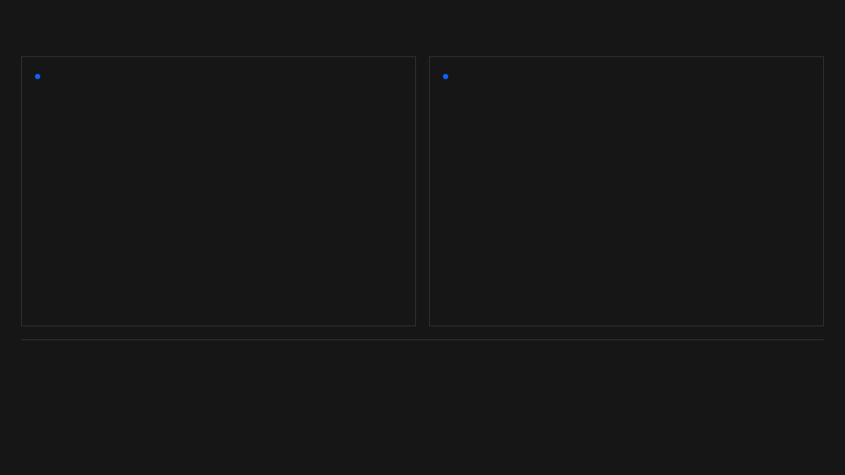
Built for IBM Bob’s moment of action
INTERCEPTION (L0)
EVIDENCE LEDGER
Native
PreToolUse
Hook
Hash-Chained Audit Log
Configured in
.bob/settings.json
. The hook intercepts every
Every decision is appended to an NDJSON log with a SHA-256 chain to the previous record. Immutable, verifiable history of agent actions.
execute_command
matching
npm install
before it ever reaches the
shell.
{ "decisionId": "uuid-001",
"action": "BLOCK",
"recordHash": "sha256:..." }
"matcher": "execute_command",
"command": "npx tsx PreToolUse.mjs"
Plan → Ask → Agent Verified.
IBM Bob is the only AI development partner with the full repository context required to fuel our claim gate. We don't just provide a tool; we provide an honest enforcement boundary for agentic workflows.
[INTEGRATION: IBM_BOB_2.0_CORE]
REF: .BOB/SETTINGS.JSON / .PHANTOMDEPS/DECISIONS.NDJSON
Notes:
This is native to the IBM Bob workflow. Our PreToolUse hook intercepts commands automatically, and every decision is recorded in a tamper-evident, hash-chained audit log. We don't just provide a tool; we provide an honest, auditable enforcement boundary for the whole team.

Slide 8

The prototype is measurable
205
100%
0%
1168ms
TESTS PASSING
WRONG-SYMBOL RECALL
FALSE-BLOCK RATE
AVG GATE LATENCY
EVALUATION CORPUS RESULTS (B0/B1/B2)
Scenario
Expected
Actual
Rule Citations
Hallucinated symbol in real pkg
BLOCK
BLOCK
l2.symbol_missing
Valid import (lodash.merge)
ALLOW
ALLOW
—
New pkg with install scripts
WARN
WARN
l3.risk_signal
Registry unavailable / 404
BLOCK
BLOCK
l1.not_found
[METRICS: TEAM_MEASUREMENT]
REF: PHASE-14 RESULTS / EVAL/RESULTS.JSON
Notes:
The prototype is ready. 205 tests passing, 100% recall on wrong-symbol detection in our corpus, and 0% false blocks. We've optimized the offline gate to run in just over a second, ensuring security never comes at the cost of developer velocity.

Slide 9
Trust comes from what we refuse to claim
CURRENT SCOPE & BOUNDARIES
THE ROADMAP TO PRODUCTION
01
Registry-name specs for npm are first-class; URL, file, and alias forms are currently unverified.
→
Live Symbol Resolution for dynamic CommonJS exports and non-standard layouts.
02
Static export declarations (ESM/TS) are required for B2 verification; dynamic/CJS exports return UNVERIFIED.
→
Enterprise Provenance: Support for private registries via token/vault integration.
03
Zero post-approval monitoring; the gate secures the entry point, not the entire lifecycle.
→
L4 Task Fit: Deep README/intent analysis via isolated subagents for high-ambiguity packages.
[STATE: PROTOTYPE_LIMITATIONS]
REF: PRODUCT_CONTRACT.MD / ARCHITECTURE.MD
Notes:
We are honest about our boundaries. This is a prototype focused on npm registry-name specs and static export declarations. The roadmap to production includes live symbol resolution for dynamic exports, enterprise provenance for private registries, and L4 sandboxed agents for intent validation.

Slide 10

Make every AI dependency claim reviewable.
FINAL SUBMISSION ACTIONS
[01]
Review full repository & evidence logs
[02]
Verify evaluation corpus metrics (TC-001–TC-012)
[03]
Authorize final submission to IBM Bob 2.0 Hackathon
github.com/adishxm/phantomdeps
Aditya Kumar Sharma
Narayan Kumar Jha
Utkarsh Yadav
Roshan Singh
[EXIT: v0.1.0-FINAL]
BUILT WITH IBM BOB / MAY 15–17, 2026
Notes:
PhantomDeps turns opaque AI dependency claims into reviewable, auditable assets. Our repository is public, our evidence is logged, and we are ready for the IBM Bob 2.0 Hackathon. Let's build what's next in AI-assisted development—starting with a foundation of trust. Thank you.

